Slide 1
RESTAURANT BILLING APPLICATION

Slide 2
01
02
03
04
ABOUT
MODULES
WORKING
INNOVATION
This section talks about the project
This section describes the modules
Working of the project is explained in this section
Ideas pretaining to the future of the project

Slide 3
01. ABOUT US

Slide 4

ABOUT US
PYTHON
In order to manage a restaurant in a fast and easier way, GST enabled restaurant billing system is a complete solution.
It is based on python and can be used by anyone.

Slide 5
MODULES
MENU
CALCULATOR
TOTAL BAR
DISPLAY WINDOW
Food and drink items
A simple calculator
The total amount is calculated
The receipt is displayed here

Slide 6
THE BENEFITS OF THIS APPLICATION
CONVENIENCE
FAST & EASY
MANAGEMENT
The application is very convenient as it can run on any system with a python compiler
The designed billing system is fast and can be easily used by anyone
It save a lot of time and also generates a receipt of the bill

Slide 7
02.THE WORKING

Slide 8
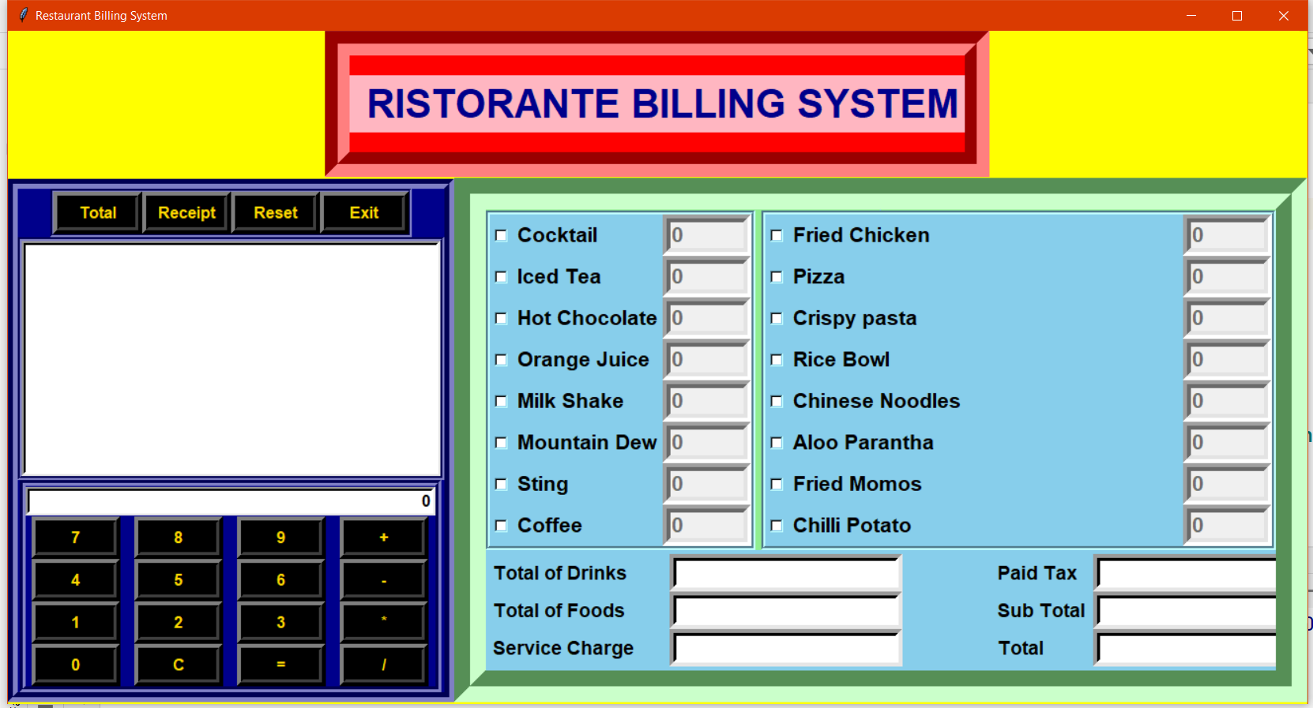
THE INTERFACE

Slide 9
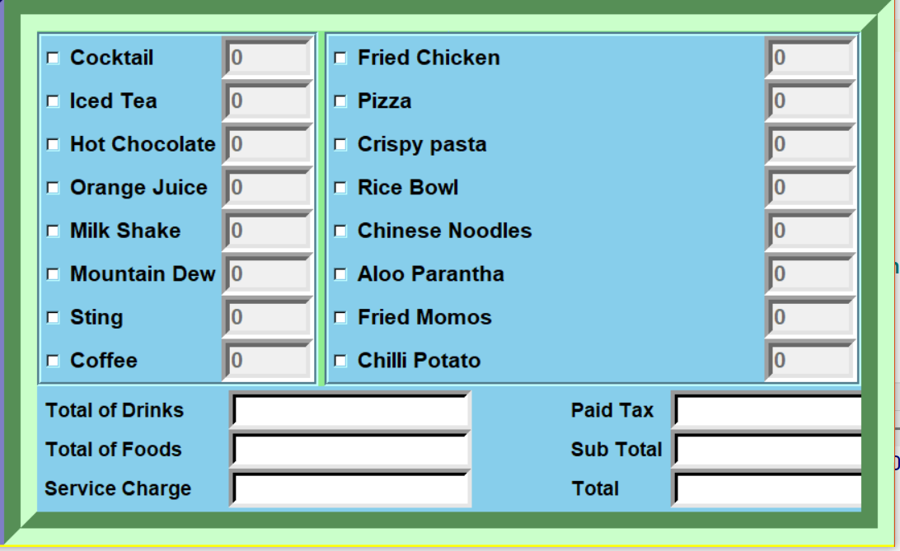
MENU
This is the menu of the restaurant; the restaurant has two different sections.
The food section and the drinks section.

Slide 10
TOTAL TAB
The total tab displays the total that must be paid by the customer at the same time it also bifurcates the tax and subtotal giving the complete demarcation of the bill.

Slide 11
CALCULATOR AND DISPLAY
This is a simple calculator attached in the application that helps to perform simple applications. The calculator is integrated with a display screen that generates the bill receipt of the customer.

Slide 12
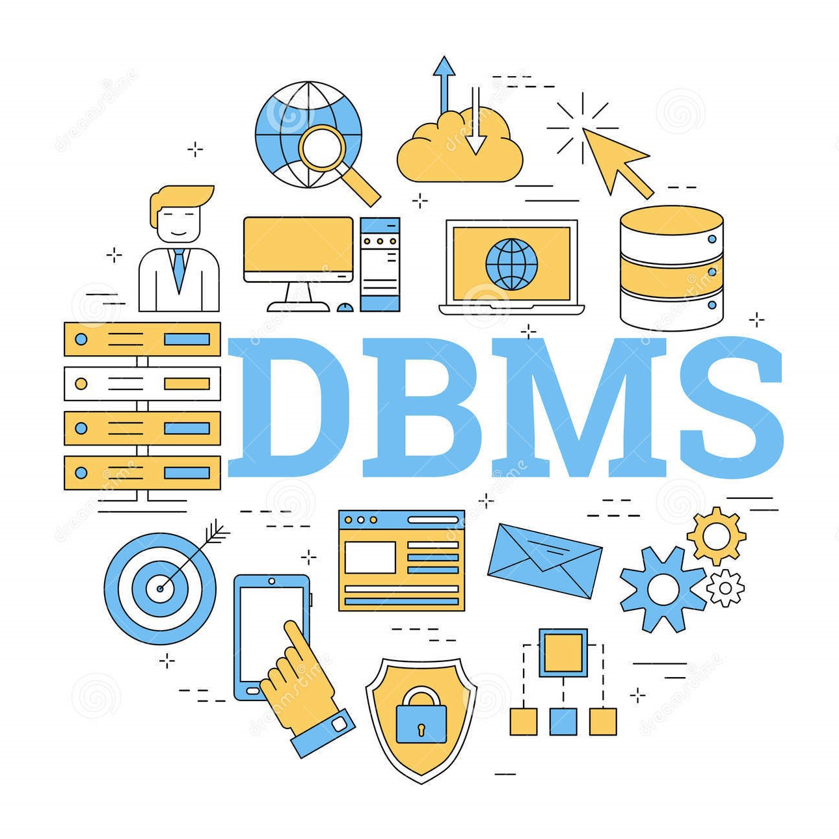
Database Maintenance
We have also added database management system which would maintain the records of orders for future references.

Slide 13
INNOVATION FOR FUTURE
The owner should be able to gain an insight of restaurant activity. This would help to make better plans for a restaurant. One should be able to figure out what items are being sold greatly, what dishes are sold abundantly and so forth.

Slide 14
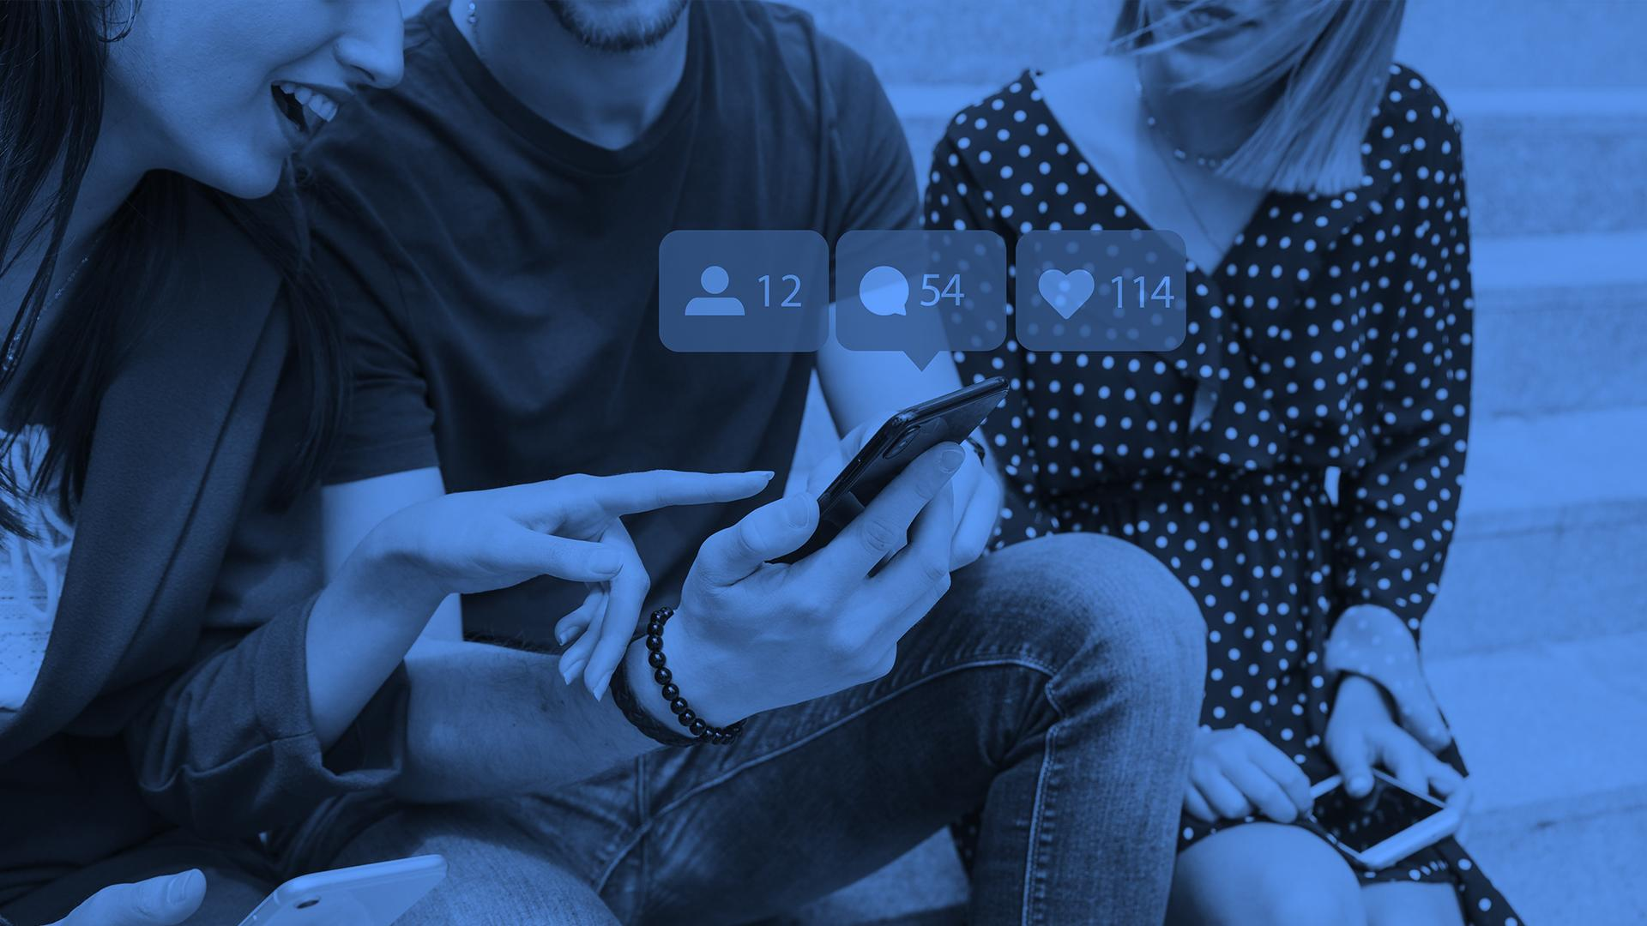
THANKS! FOR YOUR VALUABLE TIME

